Slide 1

7th EFSPI Regulatory Statistics Workshop - Summary / Overview / Highlights
An Interface meeting between Clinical, Statistics and Regulatory
14 – 15 September 2022

Slide 2
The 7th EFSPI Workshop was held on September 14-15, 2022 in Basel, Switzerland.
This is a one-of-a kind open forum with dialog between industry, global regulators, HTA assessors and academics.
The workshop format was hybrid, with 200 in-person attendees and 600 registrations overall from 29 countries.
The audience included colleagues from a variety of function: statisticians, clinicians, regulatory, global program heads, epidemiologists and HTA.

Slide 3
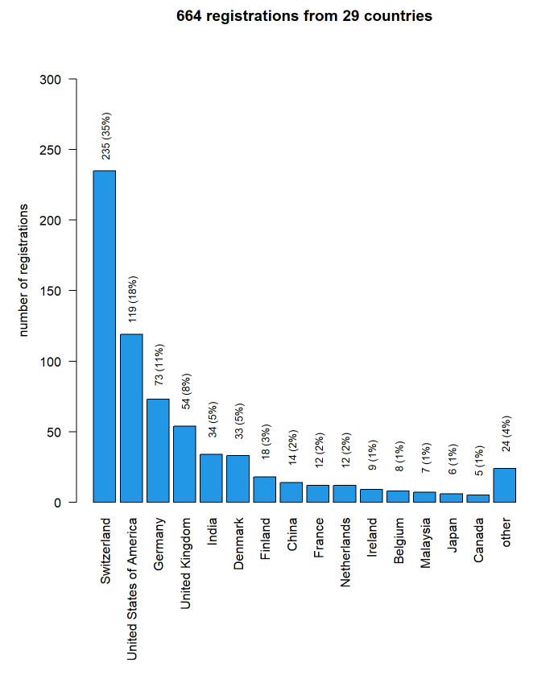
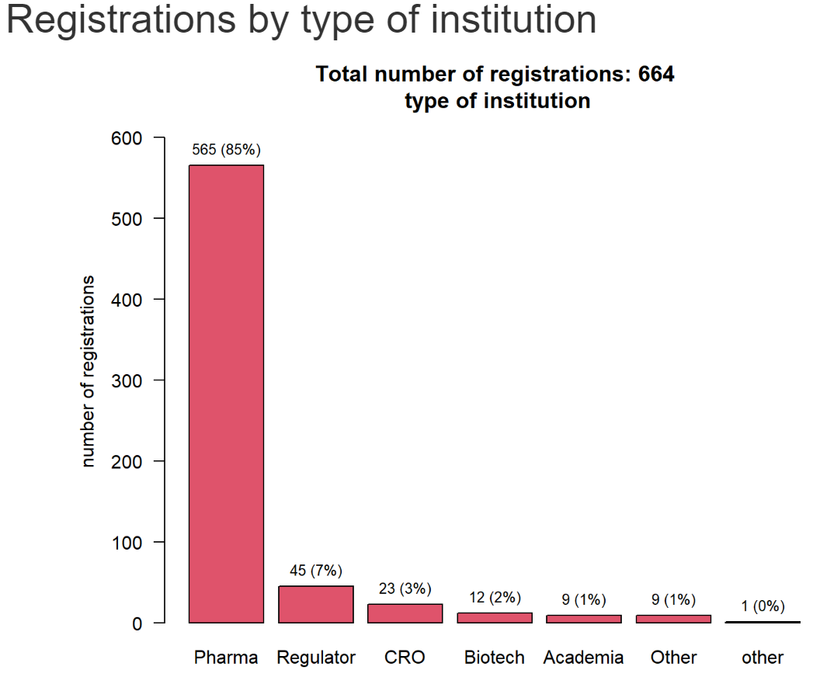
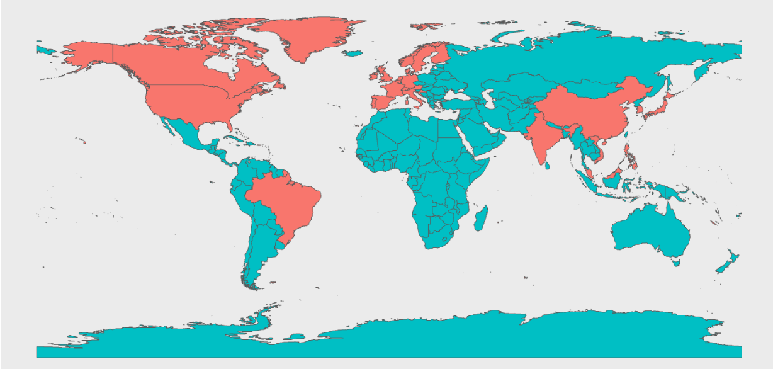
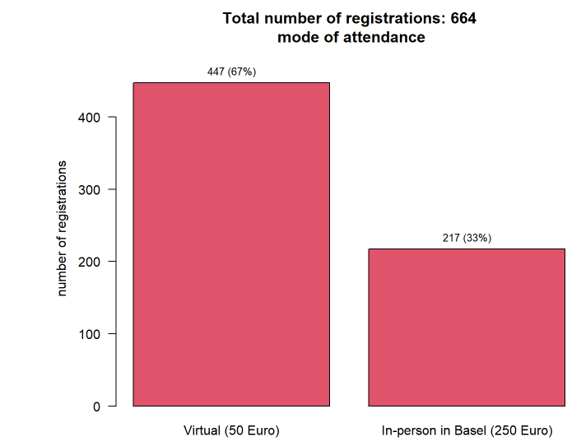
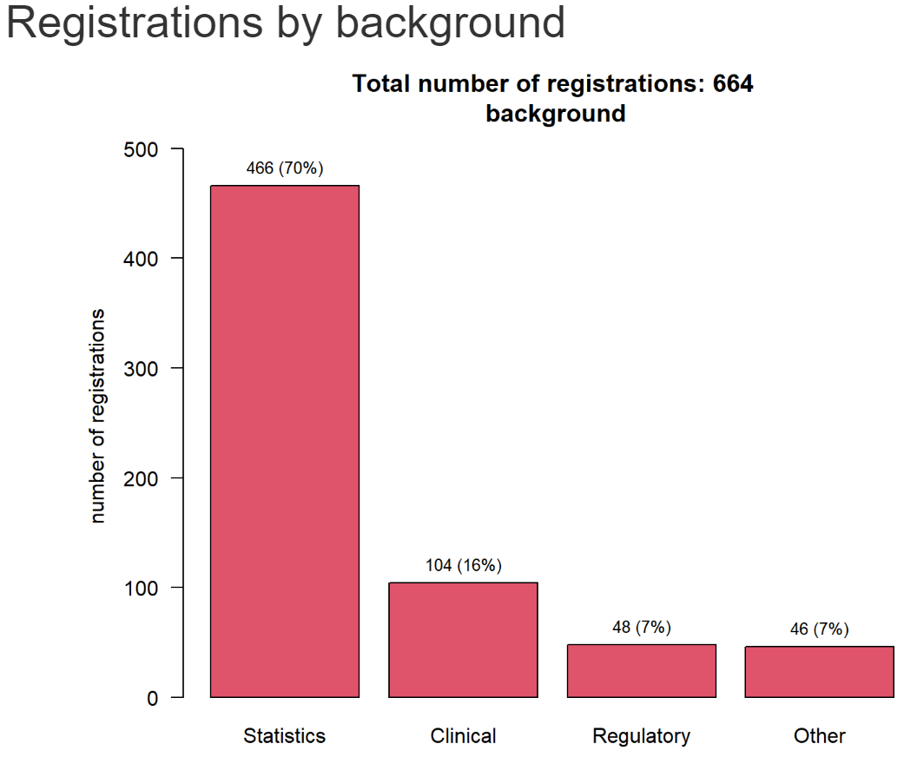
7th Regulatory Statistics Workshop

Slide 4
Day 1: morning

Slide 5
Introductory Keynotes: Regulator on "What happened in the last two years in regulatory and HTA landscape“ Session chairs: Randi Gron (Novo Nordisk) and Eftychia-Eirini Psarelli (EMA)
Recording Link: What happened in the last 2 years in regulatory and HTA landscape
Talk 1 (recording from 10:45 – 35:35 min): Kit Roes, EMA & Radboud UMC : Methodology in the regulatory landscape: guidances / restructuring / new ways to interact with stakeholders
Talk 2 (recording from 36:00 min – 1:01:01 hr): Frank Bretz, Novartis: What happened in the last two years in industry?
Talk 3 (recording from 1:01:15 – 1:18:22 hr): Anja Schiel, EMA & Norwegian Medicines Agency: What happened in the last two years in HTA – Is Winter coming? A selection of "HTA hot topics" that need discussion in coming months

Slide 6
Quotes from Session 1
00:22:00 «A lot is happening around data.» Kit Roes
00:34:30 «If we move towards more complex models we will be challenged on keeping the confirmatory nature.» Kit Roes
00:44:00 «If feel there is an increased awareness for the need of causal inference methods in pharmaceutical statistics.» Frank Bretz
01:03:30 «Winter is coming and you should be afraid of what it is!» Anja Schiel, referring to the go live of EUnetHTA 21
01:09:45 «Are you really asking the right questions when you come for a joint clinical assessment? Why are you just asking the same questions as for scientific advice, that is the wrong one!»

Slide 7
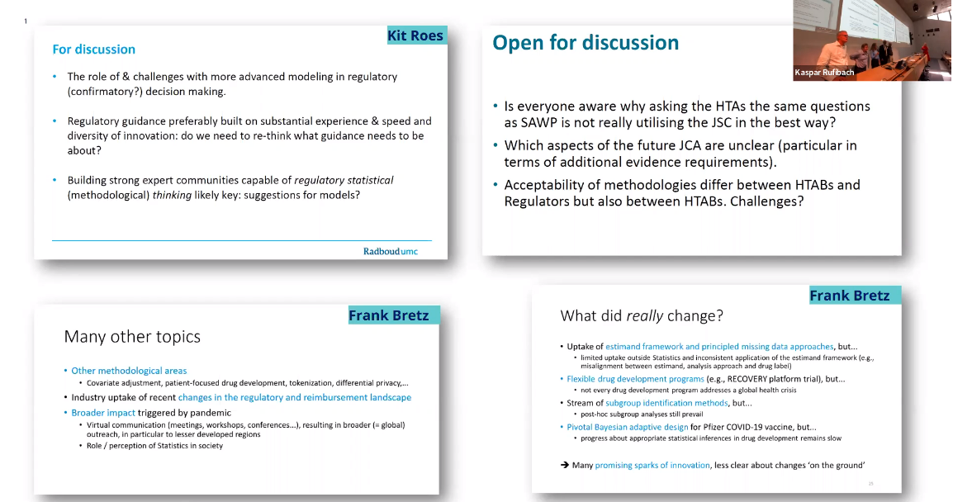
Panel discussion with Kit Roes, Anja Schiel, Frank Bretz, Jasvinder Singh (1/2) Session chairs: Randi Gron (Novo Nordisk) and Eftychia-Eirini Psarelli (EMA)
Recording Link: What happened in the last two years in regulatory and HTA landscape

Slide 8
Panel discussion with Kit Roes, Anja Schiel, Frank Bretz, Jasvinder Singh (2/2) Session chairs: Randi Gron (Novo Nordisk) and Eftychia-Eirini Psarelli (EMA)
Recording Link: What happened in the last two years in regulatory and HTA landscape
recording from 06:47 – 08:56 min: Anja Schiel: why you should aim to simplify trials rather than to design complex trials
recording from 15:16 – 18:34 min: Anja Schiel: HTA questions are addressed too late; HTAs don`t demand p-values; HTAs will not align with regulators (which provoked Kit Roes to say that he and Anja might not agree on this)
recording from 41:22 – 46:07 min: Discussion on “phase III is the best we can do to answer question of interest” & “don`t mix RCT and RWD”
recording from 48:00 – 51:40 min: Importance of early dialogue with regulators; no penalization for generating more data

Slide 9
Quotes from panel discussion
00:01:10 «What is preventing us to do it a bit more simple?» Kit Roes
00:19:30 «We do not take decisions about patients in the trial, we take decisions about patients in the future.» Kit Roes

Slide 10
Feedback & Learnings:
day 1 morning

Slide 11
Feedback & Learnings Industry Regulatory view (1/3)
Regulator: (Presenter Kit Roes, Chair EMA Methodology working party)
Every presenter was indicating that the presentations shared are personal views
“It’s not always acceptable to pursue CT’s the way ICH E9 was established – especially for patients” – indicating a high level of openness to discuss alternative approaches.
Introduction into complex clinical trials and ACT-EU
Industry: (Presenter Frank Bretz - Presentation of Novartis Initiative FACTIVE – Flexible Augmented Clincial Trial design for Improved eVidencE generation
Patients Screened for augmentd Ph 3 trial under one single protocol (for now under the assumption of the same endpoint)
Anja Schiel developed this process together with Frank
It might be good to discuss this approach with Frank in further detail.

Slide 12
Feedback & Learnings Industry Regulatory view (2/3)
HTA: Anja Schiel
Anja Schiel referred to the upcoming Joint Clinical Assessment (JCA) in the EU: Pan-European HTA for drugs and medical devices will become reality as “Winter is coming“
JCA: The central pillar of the new EU-HTA regulation (24 out of 27 EU member states will be participating).
The JCA will be organized and coordinated by the “Member State Coordination Group on Health Technology Assessment” (Coordination Group) that will be composed of representatives of all EU member states. Similar to the scientific evaluation of marketing authorization applications by the EMA, the JCA will be conducted by an assessor and co-assessor. These assessors will be from different member states and will carry out the clinical assessment, prepare a draft report, and consult relevant stakeholders. The Coordination Group will thereafter approve the reports, which will then be published by the European Commission. The timing of JCA for medicinal products will be coordinated with the central marketing authorization procedure (ie, EU Commission granting marketing authorization), ensuring its timeliness for supporting member states’ decision making at the time of launch. It is of particular importance that the JCA at EU level is strictly separate from value judgments, especially in terms of medical added benefit, which will continue to be made exclusively at the national level.
Starting with oncology drugs and advanced therapy medicinal products in 2025, the JCA’s mandate will be to systematically assess all available clinical evidence for new drugs. Once fully implemented by 2030, all drugs that will be registered by the EMA via the centralized procedure will be subject to a JCA. The JCA is designed to take different member states’ specific requirements into account, namely the definition of the standard of care against which evidence needs to be provided and the priorities and preferences regarding clinical outcomes. The further provision of country-specific evidence and clinical data will therefore most likely be needed.
Internal question to be addressed: who is informing about, raising awareness and “implementing” the JCA within Market Access ?

Slide 13
Feedback & Learnings Industry Regulatory view (3/3)
HTA: Anja Schiel
Anja Schiel was very insisting to have the PICO ready and discuss with HTA the development plan of the PICO upfront to have the right data available at the right time
What is the PICO framework?
The PICO framework provides a standard format for the definition of a research question, e.g. for a comparative assessment of the effectiveness and safety of various treatment options.
Within the PICO framework research questions are defined using (at minimum) the following components:
P (population) the patients or population(s) in which the intervention under assessment should be used
I (intervention) the therapeutic, diagnostic or preventive intervention under assessment (incl. setting)
C (comparator) the alternative intervention(s) against which the intervention under assessment should be compared
O (outcomes) the outcomes of interest (if relevant incl. minimum follow-up time)
According to Anja Schiel, platform trial should be discussed with HTA as well
Also Anja Schiel was saying that Single Arm trials are a no go for HTA – pre-negotiations with HTA needs to happen
Anja Schiel was very vocal and honest during the meeting.
This triggered some questions I would have internally, I was wondering how we are set up for JSA and as mentioned how JCA is established?

Slide 14
Feedback & Learnings Industry Statistics view
Highlights/learnings from day 1 morning session
new structure of statistics at EMA
“...many designs can be innovative without being complex”
Decentralized Clinical Trials(DCT): From the COVID-19 experience... to deeper considerations
FACTIVE: Flexible Augmented Clinical Trial design for Improved eVidencE generation
PICO
concept of generalizing study results to the indicated population

Slide 15
Feedback & Learnings Industry Clinical view
Highlights/learnings from day 1 morning session
Methodology in regulatory landscape: useful session on first day that walked through ICHE9 to EMA methodology working party and growing partnership since 2009 of statisticians and HA.
Changing landscape of last 2 years: Estimand framework, decentralized trials, master protocol design and augmenting phase 3 trials.
Awareness/warning on 2025 legislation HTA regulation. EUnetHTA 21
Clinical trials are expanding and not just focusing on RCT but real world conditions, AI and real world evidence has a key role now in submission processes and clinical trial protocol design – this may be important and applicable especially in studies with small numbers (e.g. pediatrics) whereby supportive evidence may support key submissions, and increased consideration to this approach is important during protocol design (E.g. Publication from Janet Woodcock NEJM master protocols at design stage PhIII which provides good framework)
The role of estimands is increasing (beyond ICH E9 (R1) – e.g. during COVID-19 (as mitigation strategy); clinical guidances are increasing on estimands. Update guidance documents to include this evolving field (e.g. presenters noted during Q&A current guidance pretty sure doesn’t note word estimand however it is used so extensively)

Slide 16
Day 1: afternoon

Slide 17
Postbaseline subpopulation analyses: Known to be improper, but frequently done. Can we fix them? Session chairs: Mouna Akacha (Novartis) and Khadija Rantell (MHRA)
Recording Link: Postbaseline subpopulation analyses: Known to be improper, but frequently done. Can we fix them?
Talk 1 + Q&A (recording from 01:41 – 32:40 min): Björn Bornkamp, Novartis: Post-baseline subgroups: relevant scientific questions for drug development
Talk 2 + Q&A (recording from 33:05 min – 1:10:28 hr): Anja Schiel, EMA & Norwegian Medicines Agency: Relevant scientific questions for HTA

Slide 18
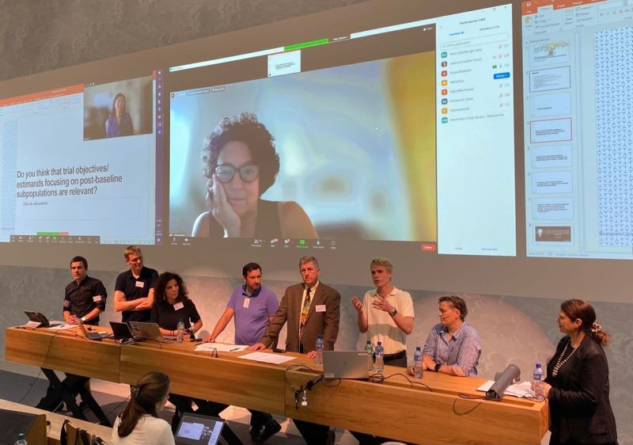
Panel discussion with Anja Schiel, Steve Ruberg, Björn Bornkamp, Mats Stensrud, Kaspar Rufibach, Fabrizia Mealli, Wanje Sun, Florian Klinglmüller Session chairs: Mouna Akacha (Novartis) and Khadija Rantell (MHRA)
Recording Link: (1:10:29 – 2:03:28 hrs) Postbaseline subpopulation analyses: Known to be improper, but frequently done. Can we fix them?
Questions for panel discussion:
Do you think that trial objectives/ estimands focusing on post-baseline subpopulations are relevant?
Can the discussed trial objectives/ estimands be the primary estimand of a confirmatory trial? Yes/No - explain why

Slide 19
Feedback & Learnings:
day 1 afternoon

Slide 20
Feedback & Learnings Industry Statistics view
Highlights/learnings from day 1 afternoon session
Panel discussion: loved the voting questions by Mouna and the provocative examples by Steve Ruberg, challenging the treatment policy estimand. I don't recall the exact phrasing, but I liked that they pushed everyone to take a stand on practical examples

Slide 21
Feedback & Learnings Industry Clinical view
Highlights/learnings from day 1 afternoon session
Discussion on post baseline subpopulations and differences between subgroups and sub populations: what exists at baseline and what is defined by post randomization events.
Cosentyx example of a clever design which reduced the need for assumptions by re randomizing and up titrating patients in one arm of Ph3 design.

Slide 22
Day 2: morning

Slide 23
Regulators and HTA bodies for new designs in Europe - how to deal with different priorities, especially for new design types? Session chairs: Christoph Gerlinger (Bayer) and Andreas Brandt (BfARM)
Recording Link: Regulators and HTA bodies for new designs in Europe - How to deal with different priorities, especially for new design types?
Talk 1 + Q&A (recording from 01:04 – 18:56 min): Dieter Haering & Marius Thomas, Novartis: NEOS - An innovative Bayesian non-inferiority trial design in pediatric multiple sclerosis
Talk 2 + Q&A (recording from 19:10 – 43:22 min ): Theodor Framke, EMA & Med Hochschule Hannover: Regulatory view on complex innovative designs
Talk 3 + Q&A (recording from 43:35 min – 1:00:42 hr): Anders Viberg, Dental and Pharmaceutical Benefits Agency, Sweden: HTA’s view on complex innovative designs

Slide 24
Panel discussion with Anja Schiel, Kit Roes, Katharina Hees, Franz Koenig, Dieter Haering & Marius Thomas, Theodor Framke, Theodor Framke Session chairs: Christoph Gerlinger (Bayer) and Andreas Brandt (BfARM)
Recording Link: (1:01:00 – 1:58:40 hr) Regulators and HTA bodies for new designs in Europe - How to deal with different priorities, especially for new design types?
Questions for panel discussion:
What do you think are the major hurdles for innovative designs?
How do regulators and HTA bodies collaborate on the evolution of complex innovative designs?

Slide 25
Generalizability and external validity: How to generate evidence about a treatment effect? Session chairs: Kaspar Rufibach (Roche) and Kit Roes (Radboud University Medical Center & EMA)
Recording Link: Generalizability and external validity: How to generate evidence about a treatment effect?
Talk 1 + Q&A (recording from 0:46 – 20:01 min): Stephen Senn, Statistical Consultant: Clinical trials are about comparability, not generalizability
Talk 2 (recording from 20:44 – 41:48 min ): Florian Klinglmüller, AGES: Regulatory importance of generalizability
Talk 3 (recording from 43:14 – 56:37 min): Joshua Ray, Roche: Let them in or build a wall? Transporting inferences across borders

Slide 26
Panel discussion with Stephen Senn, Florian Klinglmüller, Joshua Ray, Rob Hemmings Session chairs: Kaspar Rufibach (Roche) and Kit Roes (Radboud University Medical Center & EMA)
Recording Link: (57:00 min – 1:42:30 hr) Generalizability and external validity: How to generate evidence about a treatment effect?
recording from 58:02 min – 1:08:17 hr: Rob Hemmings: some reflections

Slide 27
Feedback & Learnings:
day 2 morning

Slide 28
Feedback & Learnings Industry Statistics view
Highlights/learnings from day 2 morning session
Dieter & Marius presentation: because I am considering the value added of participating in one of the new FDA pilots, I found their slide about timelines and how long the back and forth took before finalizing the protocol a bit sobering.
Anders presentation: regarding one graphic sharing the example where payers restricted the indication to high risk but that is not where they got the most payoff. It left the impression again of a possible confusion between high risk vs. high treatment benefit.

Slide 29
Feedback & Learnings Industry Clinical view
Highlights/learnings from day 2 morning session
NEOS: innovative Bayesian non inferiority trial design in paediatric MS
Regulatory evaluation versus HTA evaluation: risk benefit evaluation versus cost effectiveness
Bayesian statistics was a big theme and the increased use of it
Generalizability vs Comparability: Whether study population can represent a wider real-world patient population is of importance for HA. As such, generalizability and external data validation come into picture of drug development. The intention is absolutely well but translation to practice is difficult and requires using appropriate scale and models. Even if so, it gives no guarantees. Maybe clinical trials are about comparability but not generalizability

Slide 30
Day 2: afternoon

Slide 31
Role of statistics / quantitative science in regulatory decision making Session chairs: Emmanuel Zuber (Novartis) and Benjamin Hofner (PEI)
Recording Link: Role of statistics / quantitative science in regulatory decision-making
Talk 1 (recording from 2:11 – 18:19 min): Aloka Chakravarty (FDA, virtual): Generating Actionable Insights Using RWD during COVID-19 pandemic
Talk 2 (recording from 19:05 – 36:32 min ): John Johnston (MHRA): Role of a statistician in regulatory decision-making; views of a clinician
Talk 3 (recording from 38:15 – 50:25 min): Yuki Ando (PMDA, virtual): Role of biostatisticians in regulatory decision making: the current discussion in Japan
Talk 4 (recording from 51:25 min – 1:08:41 hr): Rajeshwari Sridhara (FDA, virtual): Experience with the project SignifiCanT

Slide 32
Panel discussion with Rob Hemmings, Anja Schiel, Kit Roes, Aloka Chakravarty, John Johnston, Yuki Ando, Rajeshwari Sridhara Session chairs: Emmanuel Zuber (Novartis) and Benjamin Hofner (PEI)
Recording Link: (1:08:50 – 1:45:15 hr) Role of statistics / quantitative science in regulatory decision-making
recording from 1:09:45 – 1:16:20 hr: Rob Hemmings: some reflections
recording from 1:16:33 – 1:20:57 hr: Kit Roes: some reflections
recording from 1:21:00 – 1:25:52 hr: Anja Schiel: some reflections
recording from 1:26:26 – 1:27:51 hr: John Johnston: some reflections

Slide 33
Short topic session: three short topics, presentation on 2 slides, get input from panel (= all regulators) Session chairs: Uli Burger (Roche) and Armin Koch (University Hannover & EMA)
Recording Link: Short topic session & Closure
Talk 1 & discussion (recording from 01:37 – 22:17 min): Stefan Wojciekowski (BoehringerIngelheim): Bayesian borrowing from simulated paediatric patients with type 2 diabetes mellitus
Talk 2 & discussion (recording from 22:47 – 37:00 min ): Björn Holzhauer (Novartis): Adjustment for prognostic covariates in RCTs: what is the idea?
Talk 3 & discussion (recording from 37:40 – 50:19 min ): Andrea Schulze (Bayer): Methodological aspects of the war in Ukraine for clinical trials
Talk 4 & discussion (recording from 50:42 min – 1:08:45 hr): Armin Koch (Institute for Biometrics): Type-1-Error: The expectation or the “new normal”?
Talk 5 & discussion (recording from 1:09:25 – 1:25:00 hr): Vivian Lanius (Bayer): Causal (?) estimands for time-to-event endpoints

Slide 34
Feedback & Learnings:
day 2 afternoon

Slide 35
Feedback & Learnings Industry Statistics view
Feedback on day 2 afternoon session
this session felt the more disconnected from the rest, maybe because three were virtual speakers who may not have attended the rest of the conference and one was a clinician that may not have been in earlier talks either. He was overly critical of statistical terminology, especially the word significant. I found his candid message that superiority over placebo does not mean a therapy is successful if it doesn't make a meaningful clinical change refreshing...
we did not have time to reflect upon that or respond later though...so, it fell a bit flat.
It would have been nice to have a response or a dialog to some of his reflections

Slide 36
Feedback & Learnings Industry clinical view
Feedback on day 2 afternoon session
Highlights from the Oncology centre of excellence, FDA including Project Significant
•The importance of clear communication from statisticians to the scientific community was noted and ensuring the message conveyed is clear without ambiguity.

Slide 37
General Feedback

Slide 38
Highlights (general) Feedback from Stats
Some highlights
Learning about EMA Methodology WP plus new initiatives from EMA, MHRA, FDA and PMDA
Common themes: (1) Being clear about the questions we are using the data/studies to answer (2) Planning for the HTA perspectives as they may differ from the regulatory perspectives.
Discussions of value added of trial complexity. Where can we simplify and where not? What is "complex enough"?
Impact on the strategy outlined in the integrated evidence plan (IEP) and discussions (about PICOT) with payers early in the development program

Slide 39
Highlights (general) Feedback from a Clinical Team
COVID-19 introduced more flexibility with HTA (e.g. MHRA) and this was learning curve for them also with some elements remaining after COVID (e.g. remote monitoring)
P value dilemma: Not everything relies on p-value (which personally coming from academia is a new way of thinking) and with innovative statistical methods (e.g. bayesian methods, estimands and RWE, etc) with robust consideration of these methods during protocol design – if a study doesn’t meet significance as per p-value in the final analysis as per traditional methodologies, when these other innovative approaches are adopted it can support the submission process and HTA will consider the whole story if the evidence is presented.

Slide 40
Feedback (general) from a Clinical Team
Some sessions heavily dominated by debate on RWE and appeared to be divide in audience on accepting new augmented Ph3 study design and those who believe we should stick to gold standard.
Some case studies very technically challenging for clinical development: detailed overview of Estimand analysis plans and strategies.
Being a layman to regulatory affairs, I have to admit the first presentations were challenging to me, in particular while many acronyms were used.
Not familiar with HTA interactions therefore found these presentations difficult to follow.
Overall, the workshop is of great interest to me as regulatory outcome is very much impacted by trial design and data analysis
Enjoyed the balance of presentation and Q&A, very interactive style.

Slide 41
Suggestions for next conference: from a Clinical Team (1/2)
Would be interested to hear to same case study examples/overview of new regulation or guidance presented by statistician and clinical development eg: how did the proposed statistical plan affect protocol design, trial management, recruitment of patients as well as being “clever” or well received by HA.
Since Estimand framework has been implemented, what are the key learnings that we should implement when designing protocols and trials overall?
Of interest was Project SignifiCanT (Statistics in Cancer Trials) Oncology Center of Excellence, Statistics in Cancer Trials, FDA; the many guidance documents on their website was of interest and personally something I was not aware of and a good resource; additionally on their website is the option to invite speakers so might be something in the future to consider?

Slide 42
Suggestions for next conference: from a Clinical Team (2/2)
Complex trial design: High level overview of novel/complex trial design was provided, including umbrella, basket, and platform design. A Q&A document for trial design is available however still there are more questions than answers when it comes to regulatory perspectives on complex trial design. Given XXX is a platform design trial, I was hoping I could get more first-hand regulatory opinions on how they view platform trials and in the regulatory review process what pros and cons they found in platform trials. Yet very few real examples were given, nor design details were discussed- to be considered for next conference, to provide more clarity whether and when complex trial design is the right direction to move forward.
P-value: During panel discussion session, some experts said statistically significant trial result is no longer a MUST for drug approval or reimbursement. P value should not override all other things that we observe in the trial. However, experts did not elaborate on what other factors could possibly lead to drug approval even if the p value was not met. Topic for the next conference ?

